Slide 1

P peline
The Data
Final Exam Review
© Jennifer Mankoff
The Data Pipeline; HCII; Spring 2015

Slide 2
Final Project
Discussion of handin expectations: Website, presentation http://data.cmubi.org/assignments/final-project
Website URL due on Blackboard by Tuesday at 9am
Individual Handins
Include URL to your project
Write briefly about what you and each of your team mates contributed to the project
I grade work; Based on your progress; participation; presentation; and final result

Slide 3
Final Project
Presentation Expectations
15 minutes to present, 5 minutes for questions
4 groups per day
Attendance is required both days
Sample presentations slides

Slide 4
Tuesday Presenters
Home Ownership
Bus Bunching
Crime (!Alert)
Heart Disease

Slide 5
Thursday Presenters
Crime Alert!
Yelp!
Things with Wikipedia
Food Waste

Slide 6
Final Exam
Reverse final exam
You write 5 questions AND answers
Each question should cover a different aspect of the class as considered in the lectures and readings.
Questions should assume open book/notes/etc. but taken in a limited time of ½ hour per “long answer” question (less for “short answer”)
You nominate ‘best questions’; I take an exam based on those nominations ☺

Slide 7
What makes a good question?
It is clear
It stays on topic (doesn’t bring material from outside the class in)
It is not ambiguous (multiple interpretations or correct answers)
It is not obscure
More than ¼ of the class could answer it in the time allotted
It requires some thought to answer

Slide 8
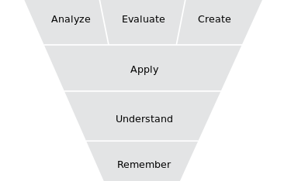
Bloom’s Taxonomy
Notes:
Helps to describe what makes questions difficult!

Slide 9
Question Types
Long Answer
Around 600 words long (including your answer)
Short Answer
Four alternative answers
Include explanation for each one of them

Slide 10
Final Exam Grading
You grade 5 x 5 questions (10 long answer, 5 peoples’ short answer questions)
Your grade is based on
How well you grade your peers (15%)
How well your peers grade you (85%)
Any adjustments I decide are needed if there are issues with the peer grading.

Slide 11
Grading Criteria
This is a good question (1)

Slide 12
Grading Criteria
This is a good question (1)
The question is clear and unambiguous (3)
3 points: Good to excellent in this regard
2 points: Question (or answer) has small problems
1 points: Question (or answer) has significant issues
0 points: Question or answer is missing

Slide 13
Grading Criteria
This is a good question (1)
The question is clear and unambiguous (3)
Right level of difficulty (not too obscure, etc.) (3)
3 points: Good to excellent in this regard
2 points: Question (or answer) has small problems
1 points: Question (or answer) has significant issues
0 points: Question or answer is missing

Slide 14
Grading Criteria
This is a good question (1)
The question is clear and unambiguous (3)
Right level of difficulty (not too obscure, etc.) (3)
The answer given is correct (3)
3 points: Good to excellent in this regard
2 points: Question (or answer) has small problems
1 points: Question (or answer) has significant issues
0 points: Question or answer is missing

Slide 15
Grading Criteria
This is a good question (1)
The question is clear and unambiguous (3)
Right level of difficulty (not too obscure, etc.) (3)
The answer given is correct (3)
The answer covers a different course topic than the other two short answer questions (1)

Slide 16
Grading criteria for your peer grading
Good written feedback on ALL questions (meaningful comments/suggestions)
Clearly explain reasons for sub-scores below 3

Slide 17
Examples of things that result in low scores on final
0: Copying text from the internet
0: Copying text from my slides
Very short explanations
Incorrect answers
Only one multiple choice answer option
Only explaining one of the multiple choice answer options

Slide 18
Final Exam Timeline
Exam opens April 28th
Must submit questions by Monday May 2nd, 11:30am (end of our normal final exam period)
Must peer grade by Thursday May 5th at Midnight

Slide 19
What I consider to be key material from the class
Will review that now to help focus you and answer any questions

Slide 20
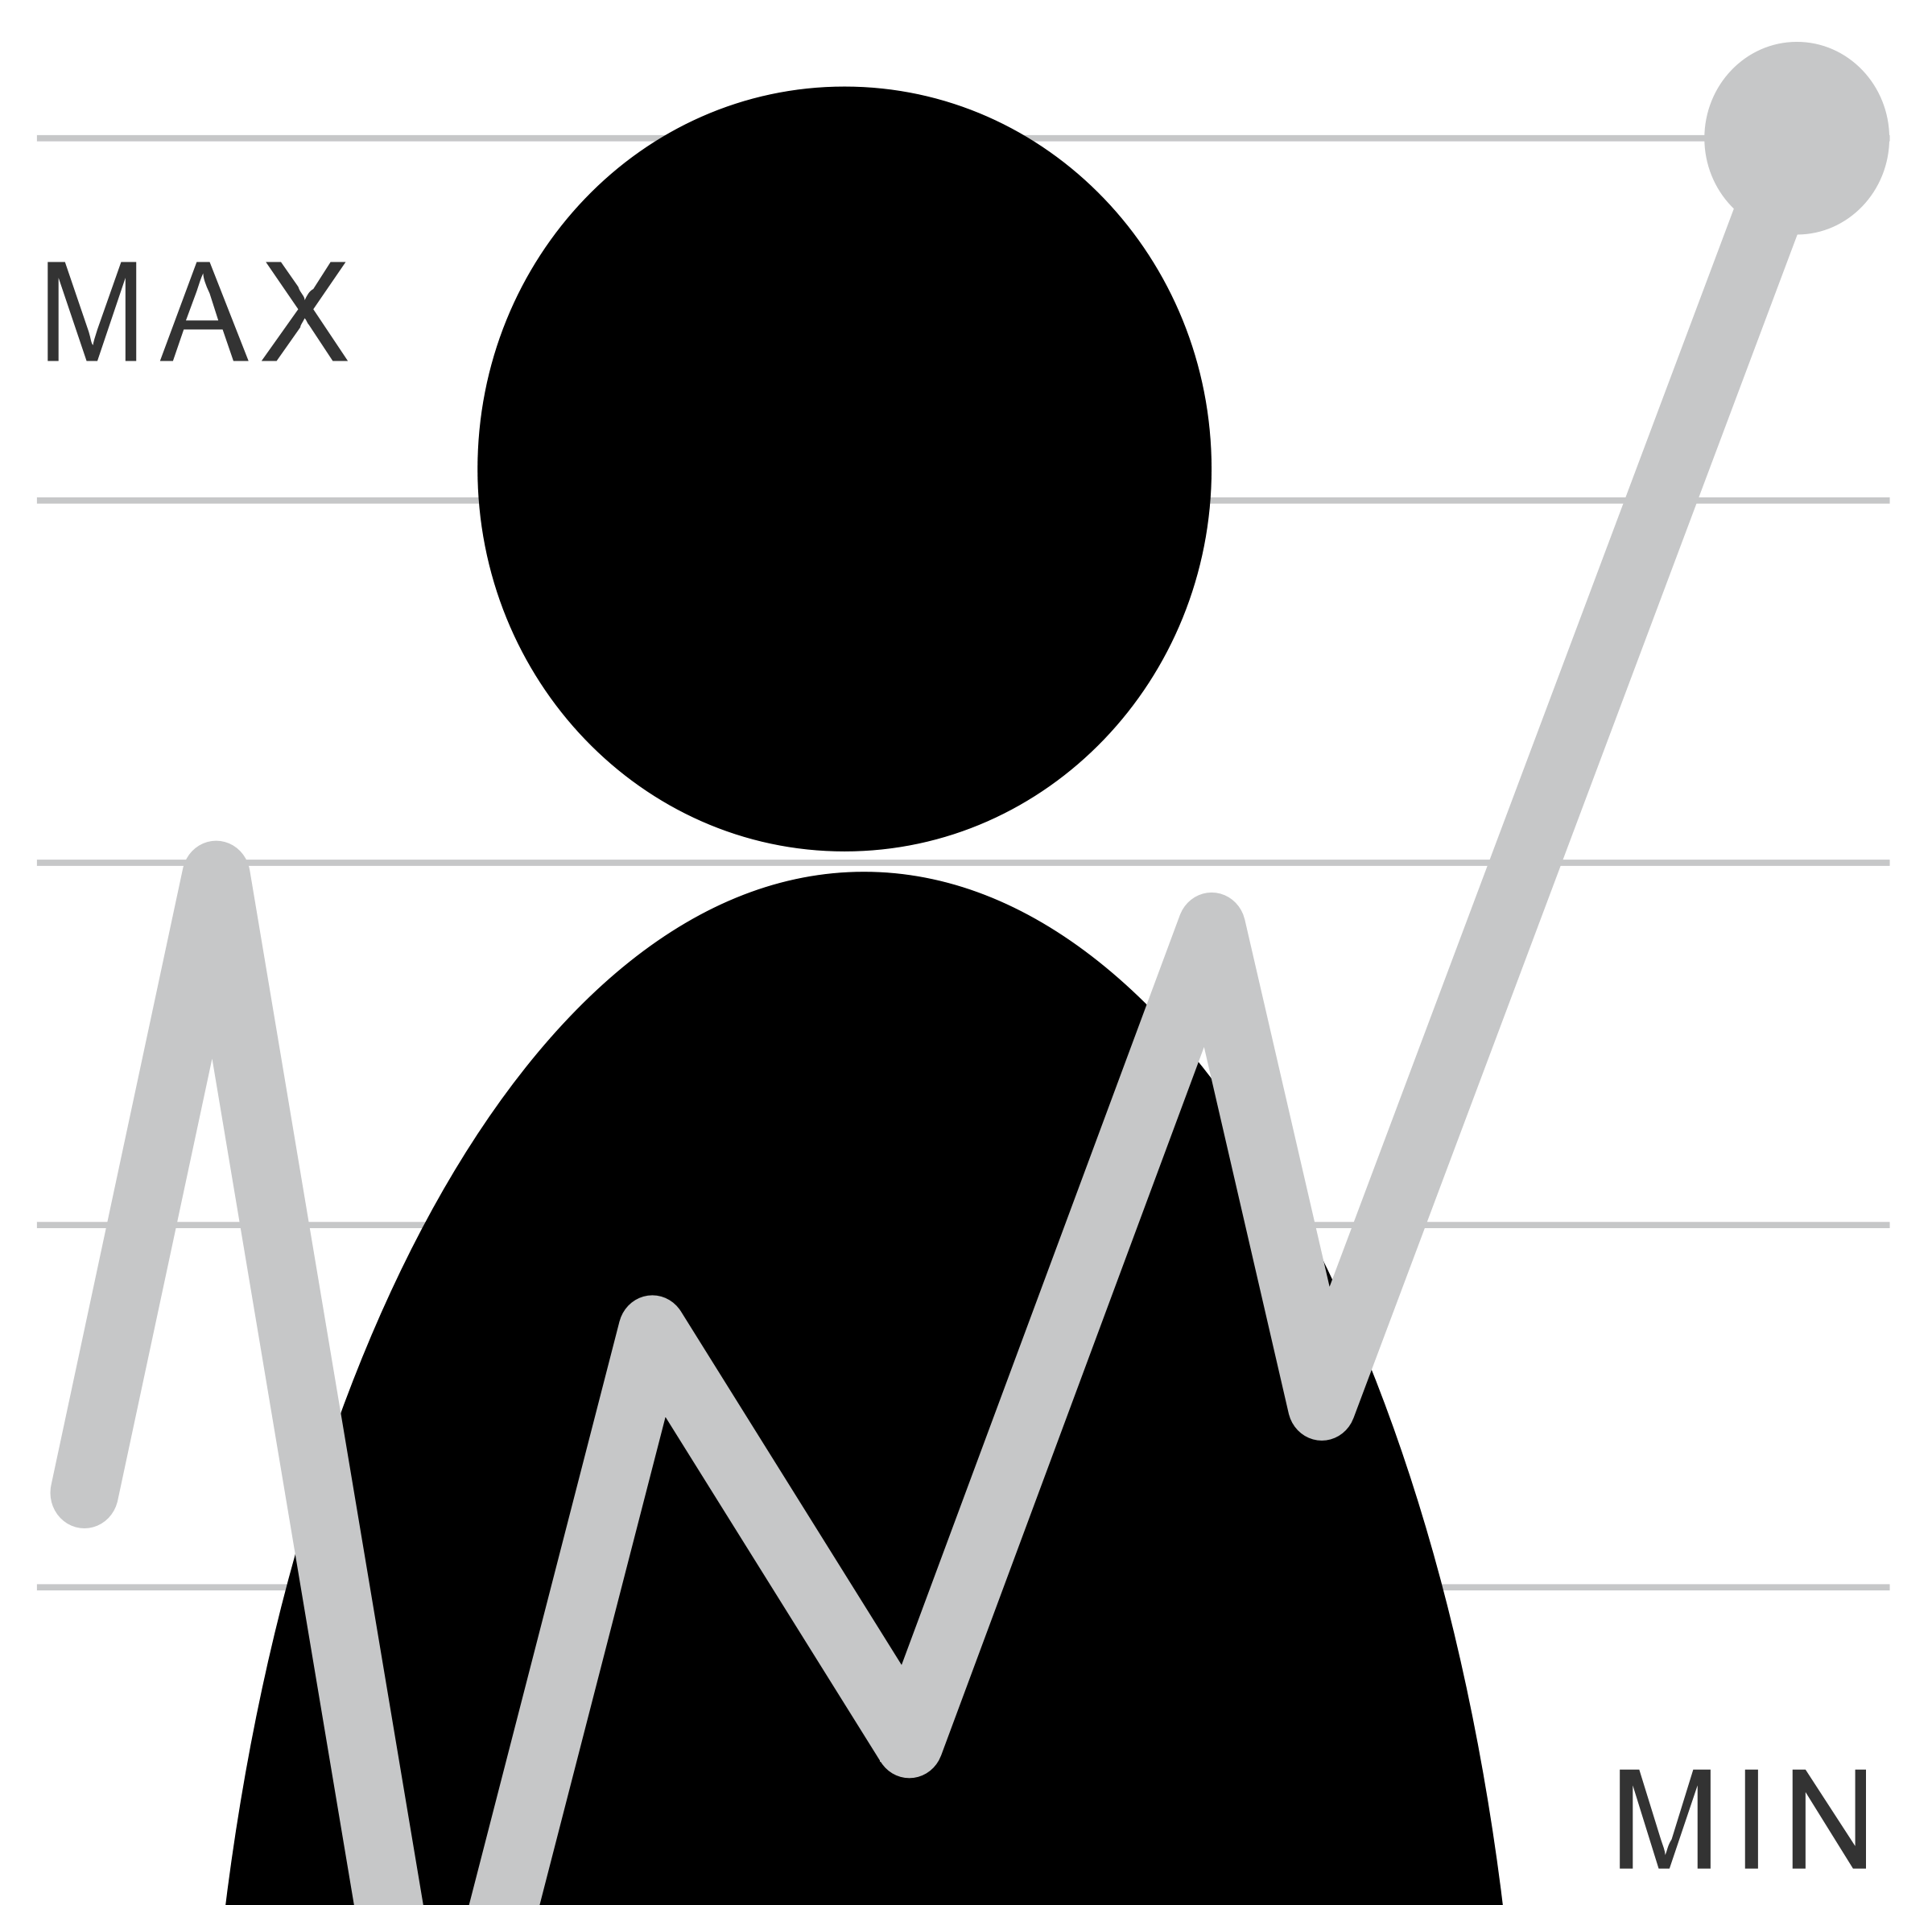
The Data Pipeline
Question
Is it the right question?
Collect Data
Is it the right data for the question?
How hard/easy is it to collect?
Clean Data
What flaws exist in the data?
How do we address them?
Is it answerable?
Explore Data
Intuition
Use data
Communicate/Predict/…
Stats/Graphs/ML
Report on Findings
Visualize

Slide 21
Goals of Exploratory Data Analysis
Summarizing the Data
Summary Tables
Descriptive statistics
Graphs
Identifying problems (such as outliers)
[eventually] Finding Hidden Relationships
Asking specific questions
Correlations
Grouping
[eventually] Making Predictions

Slide 22
What Type of Data Exist?
Constant (e.g., mouse gain)
Continuous Data: Ration/Interval (e.g., mouse location)
Discrete Data (often scales): Nominal/Ordinal
(e.g., slip/no slip on this interaction)
What are the units?
Notes:
Interval: Scales that describe values where the interval between the values has meaning. Temperature.
Ratio: Interval + clear definition of 0. Weight…

Slide 23
What Role?
Descriptor / Feature: predictive of labels (e.g. Click Duration)
Response / Label:
outcome of prediction
response to an intervention / question
(e.g. Diagnosis)
Notes:
Example scripts to address each of these?

Slide 24
Exploring your data
Transformations such as normalization, logs, and feature creation
Allows different fields to be compared
Avoids undue influence of a column that happens to have large values
Often moves data to 0-1 range
Non-linear transformations (e.g., transforming log-normal data to a normal scale by taking the log)
Notes:
----- Meeting Notes (4/23/15 09:54) -----
don't address feature creation here.

Slide 25
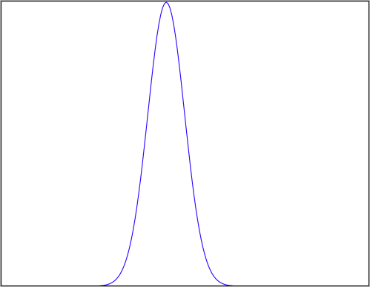
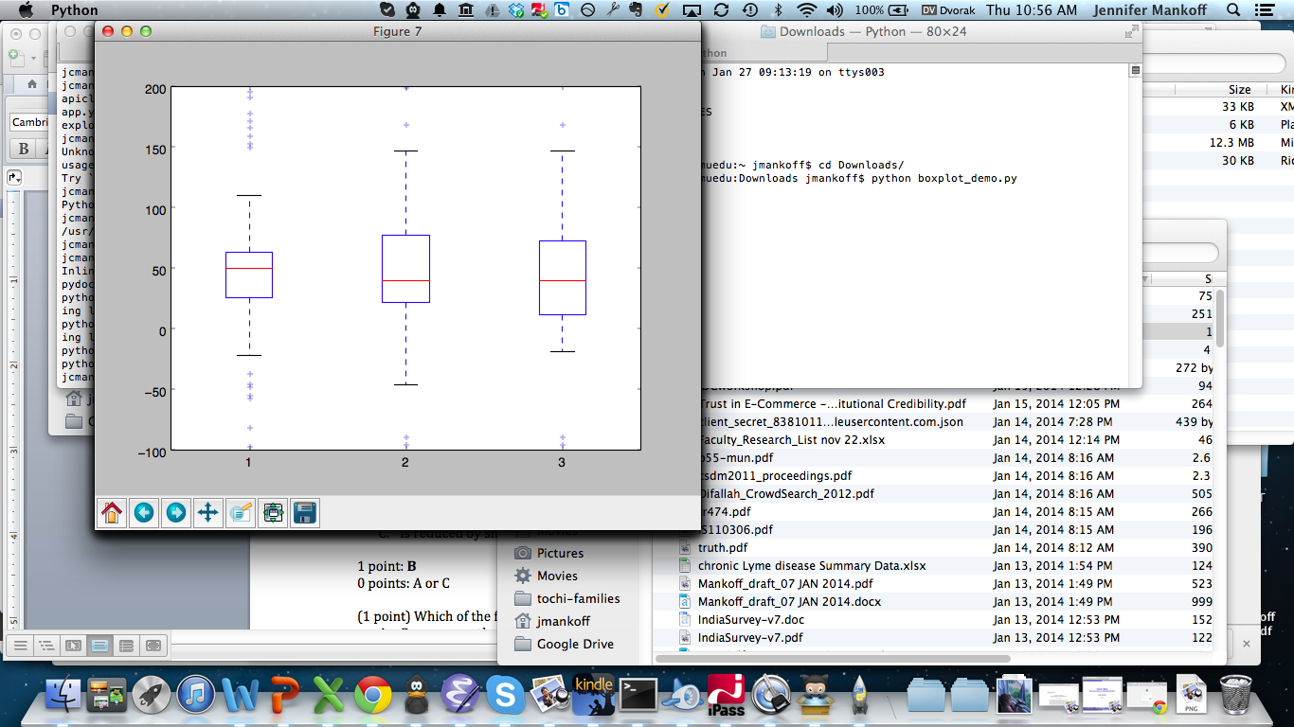
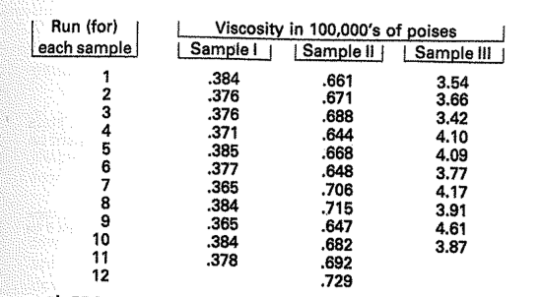
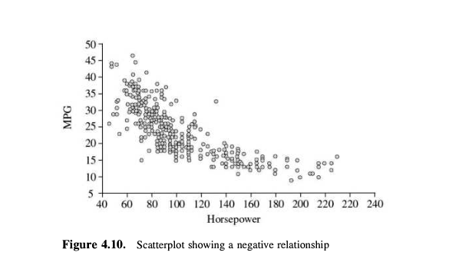
Exploring your data
Transformations such as normalization, logs, and feature creation
Plots and their value
Stem and leaf [flexible & quick]
Boxplot [comparison; some structure]
Histogram [check a distribution]
Scatterplot [show a relationship]

Slide 26
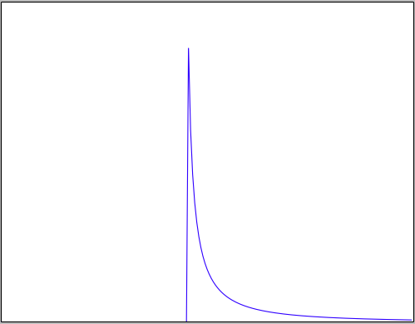
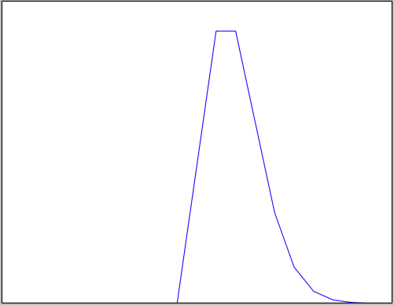
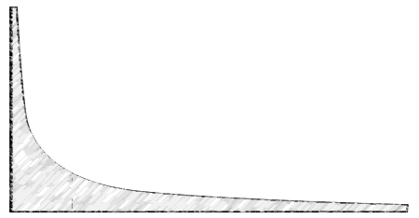
Exploring your data
Transformations such as normalization, logs, and feature creation
Plots and their value – stem & leaf; boxplot; histogram
Distributions and some of their assumptions
Normal: Independent, Identically distributed random variables
Log Normal: Multiplied independent random vars (intuitively: one end is fixed, e.g. timings all > 0)
Poission: Constant rate of independent events
Power Law: Events are not independent; Proportional to 1/k^{n}
Notes:
First reason to explore the data is to check its validity!

Slide 27
Four C’s of Data Quality
Is your data Complete?
Match the question/None missing/None wrong
Is your data Coherent?
Makes sense relative to itself (frequency, values, distribution, outliers, skew …)
Is your data Correct?
Makes sense relative to the world
Not fraudulent/erroneous/badly designed or administered survey/sensor
Is your data aCcountable?
Provenance and documentation
Notes:
First reason to

Slide 28
A process for data cleaning [Coherence & Correctness]
Define & Identify
Detect & Quantify
Detection Algorithms
Quantify Prevalence
Types of Glitches
Importance of Glitches
Clean & Rectify
Develop Strategies
Measure & Verify
Repair
Measure Improvements
Tolerance, cost & bias criteria

Slide 29
Some specific techniques to keep in mind
How to detect and quantify errors?
Glitch signature
Summary statistics
Graphs and Charts
Specific things to look for
Outlier detection techniques
Skew
Techniques for fixing
Imputation
Winsorization
De-Duplication
Domain specific approaches
Notes:
Winsorization: limit outliers (extreme values) to e.g. 90%

Slide 30
Data Acquisition
Lots of existing data
Data streams are a valuable source of data
Need to address security issues
OAuth (2.0) is the current standard
Gives the user / data source control over whether you have access & for how long
Once you get permission you use a key to access the data

Slide 31
Acquiring Data
Data sampling issues
Understand terms: Population, Sample, Random Sampling Error, Bias
Understand what makes a good sample
Understand types of Bias
Systematic Bias, Selection Bias, Non-response Bias
Understand how changing population size affects different types of error [larger sample decreases random sampling error; dosen’t affect Bias]

Slide 32
Two ways to store data
Data spread over multiple structures that reference each other [Database]
All data in a single structure [JSON; XML; API calls (even over a database)]
Data may include multiple types such as strings and numbers [Both]
Notes:
Many said single structure for database
I would say that’s not true in a typical production database today

Slide 33
Data Storage
Data Management is a people problem
Who should oversee it?
Requires lots of attention, over time, regular checks, etc.
Who is responsible for the four Cs? (Completeness, Coherence, Correctness, AcCountability)
Types of data
Unstructured/semistructured/structured

Slide 34
What is a Data Model?
What data is stored and how it is organized
Key benefits:
Leverage (big impact on programming; cost; etc.)
Conciseness (implies an interaction model)
Can encode integrity constraints
Know what makes a good data model (concise, stable & flexible, quick, elegant…)
Notes:
For programs:

Slide 35
Dealing with very large data
Typically distributed [may lead to partitions; maximize consistency or availability: CAP]
Types of data bases to consider
Key-value stores [fast collection, slower query]; e.g. Redis
Distributed, fast schemas [append only, good for exploratino]; e.g. Dremel, BigQuery
Need to consider data processing too
Map-reduce framework for parallelizing operations: batch work
Distributed queries & insertions (e.g. Hive)
Distributed ML (e.g. MAHOOT)

Slide 36
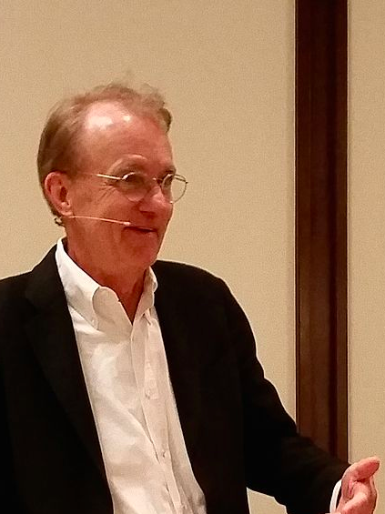
Planning a Visualization
What is its goal?
Does it support comparisons?
Causality, Mechanism, Structure, Explanation?
Multivariate analysis?
Integration of Evidence?
Documentation? [process & provenance]
Content (Most Important)
Don’t Lie!
Tufte (Yale)
Notes:
Avoid Ch

Slide 37
Narrative in Visualization
Documenting the question you are answering
Leading the viewer through a story
Another Example: http://projects.propublica.org/extinctions/

Slide 38
Narrative Tactics
Visual Structures (establishing shot, checklist, consistent visual platform)
Highlighting (color, motion, framing, size, audio, and more) – relates to last Tuesday’s perceptual characteristics
Transitions (McCloud; animation principals; etc)

Slide 39
Narrative framing choices
Obscuring
Leveraging Perceptual effects (from last Tuesday) to imply things whether or not correct
Using redundancy to emphasize
Using grouping
Contrast
…
Using Linguistic effects (irony, metaphor, etc)
Notes:
Democratic health plan…

Slide 40
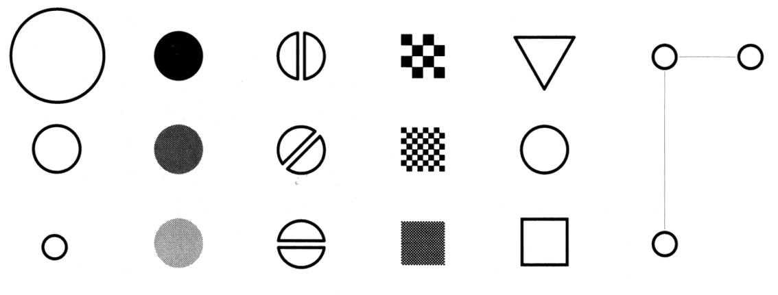
Making Things Distinct
Size
Value
Orientation
Texture
Shape
Position (2D / 3D)
Bertin’s ‘retinal variables’ form the basis for all forms of visual coding. A visual code can be based on (from left to right) contrasts of different types. Hue (chromatic color) provides an addition dimension not shown here.
Kevin Mullet and Darrell Sano, Designing Visual Interfaces
Slide from Marti Hearst/Jeff Heer via Jason Hong
Notes:
Note that while size and other cues provide for quantitative comparison, color (even luminance) only provides for ordering.
If the goal is contrast along any of these axes, make it distinct!

Slide 41
Pattern Perception
Problem components are identified & Formed into visual queries
Eye searches the screen, driven by expectations of what to attend to
Query determines what to focus on in each ‘fixation’
Long term memory can guide this
Working memory in play for new things (e.g. legends) – only 3-4 though!
Links to propositions are activated by icons or recognizable patterns

Slide 42
Ware Reading
Support pattern finding capabilities
Optimize for activity at different levels
Take economies of cognition into account (e.g. cost of learning new representations/tools)
Saccade: 100ms [50-200]
Cognitive Cycle: 70ms [25-170]
Motor Action: ~70ms [30-100]
Expert action: ~250ms (see/compute/act) Learning: MUCH MUCH slower

Slide 43
A summary of design elements
Use the eye for pattern recognition: people are good at
Scanning
Recognizing
Remembering images
What they do depends on their “visual query”
Tends to be “just in time”
Key graphical elements
Length
Shape
Orientation
Texture
Animation shows changes across time
Color helps make distinctions
Aesthetics make the process appealing

Slide 44
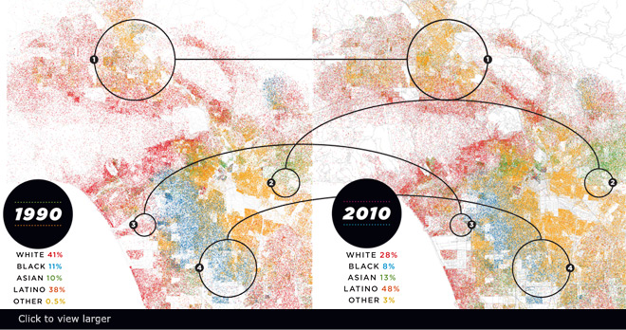
Visualizing Big Data
Make use of every pixel
Notes:
----- Meeting Notes (3/26/15 09:10) -----
storytelling

Slide 45
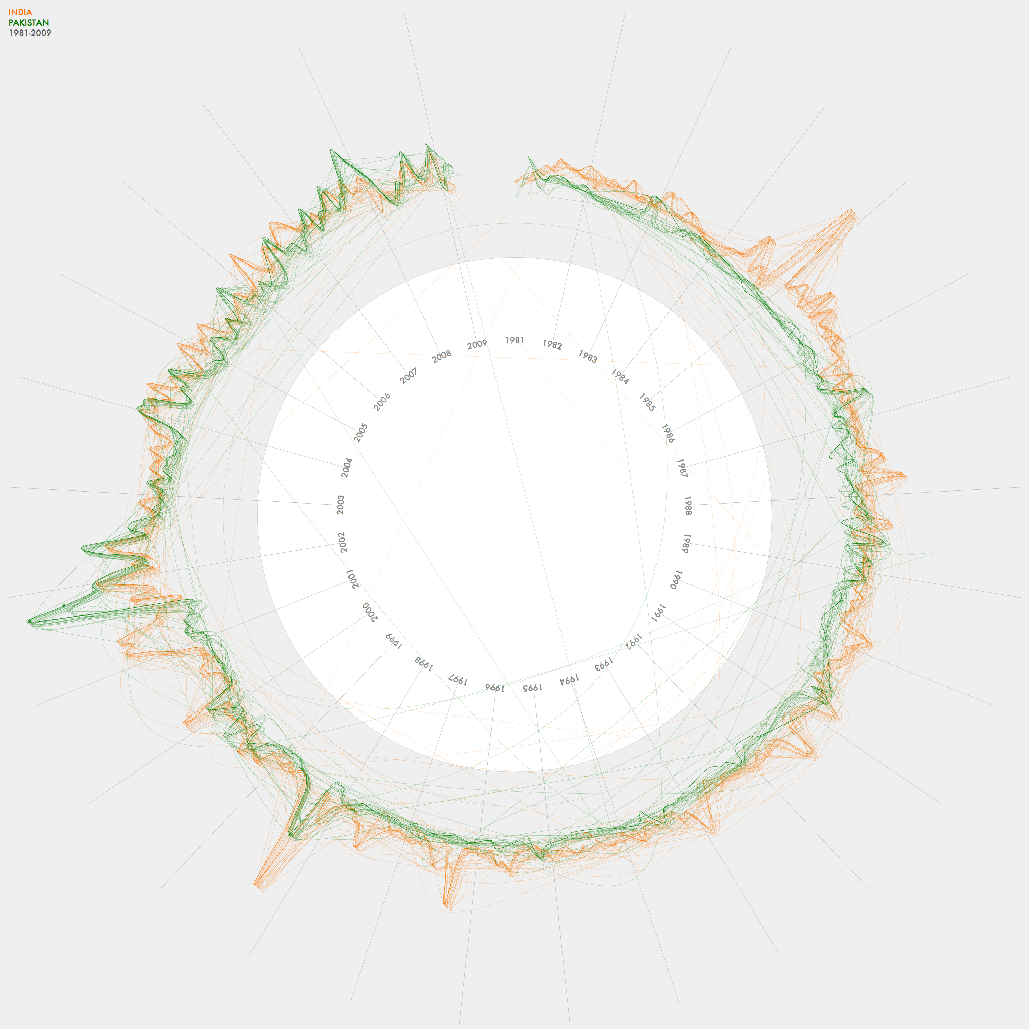
Visualizing Big Data
Make use of every pixel
Use color and location to break the data up and allow the viewer to easily filter

Slide 46
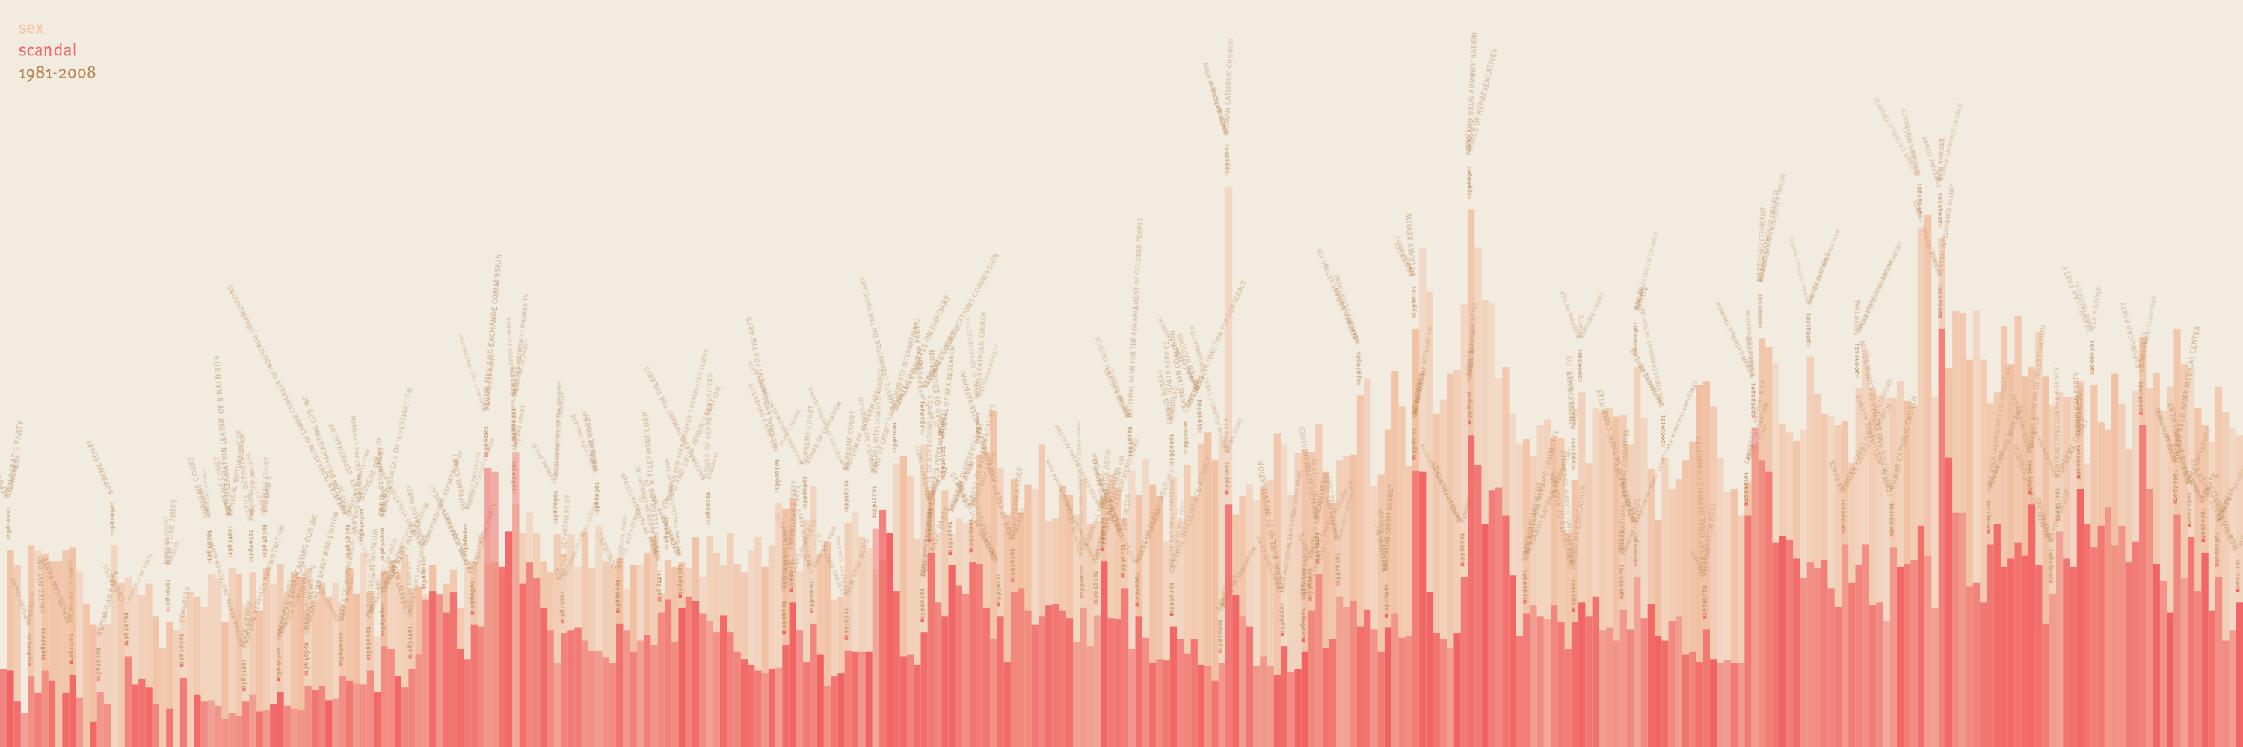
Visualizing Big Data
Make use of every pixel
Use color and location to break the data up and allow the viewer to easily filter
Give a sense of things and use zooming for detail

Slide 47
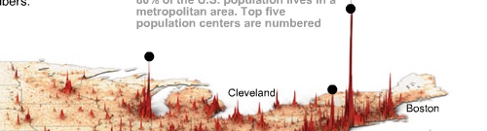
Visualizing Big Data
Make use of every pixel
Use color and location to break the data up and allow the viewer to easily filter
Give a sense of things and use zooming for detail
Add a dimension such as time or height for a key variable

Slide 48
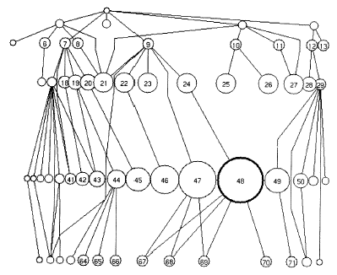
Visualizing Big Data
Make use of every pixel
Use color and location to break the data up and allow the viewer to easily filter
Give a sense of things and use zooming for detail
Add a dimension such as time or height for a key variable
Allow exploration through distortion, filtering, highlighting, and linking

Slide 49
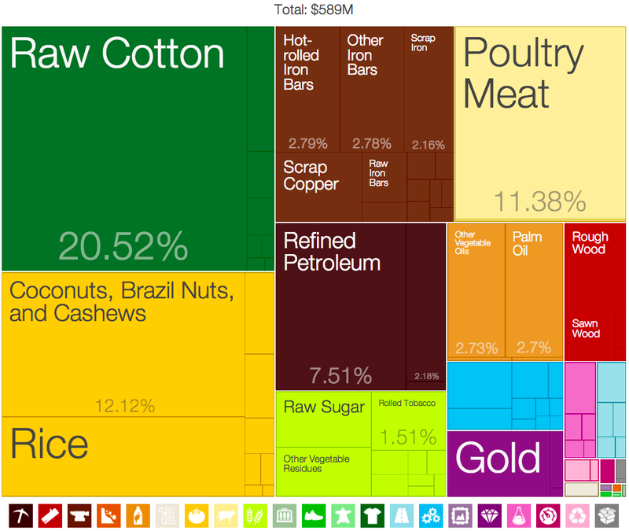
Visualizing Big Data
Make use of every pixel
Use color and location to break the data up and allow the viewer to easily filter
Give a sense of things and use zooming for detail
Add a dimension such as time or height for a key variable
Allow exploration through distortion, filtering, highlighting, and linking
Exploit hierarchy and connectivity

Slide 50
Analyzing your data
Potential for Logical Error
Potential for Systematic Error
Formulate
hypotheses
(Collect) & Analyze data to test hypotheses
Potential for
Random Error
Potential for Errors of Interpretation
Accept hypothesis
Reject hypothesis
Notes:
Start with process data and analysis, only then explore frequency data and analysis

Slide 51
Summary
A cause implies interdependence
Scatterplots/correlation can highlight the existence of such relationships (but not prove causality)
T-tests are limited, and based on frequency data
A theory of the world (process data) can improve the quality of your results and give probabilities rather than yes/no results

Slide 52
Four relations
Despite
y is Y despite x if the probability of Y is lowered after x_{t’}
Because
y is Y because of x if the probability of Y is increased after x_{t’} and remains increased until y_{t}
Autonomously
y is Y autonomously of x if the probability of Y changes at x_{t’}, this probability is high, but then decreases before y_{t}
Independently
y is Y independently of x if the probability of Y is the same just after x_{t’} as it is just before x_{t’}

Slide 53
Dependence/independence
Events that are independent
Flipping heads and then tails
Day of week and whether a patient had a heart attack (probably?)
Events that are dependent
Vice presidential candidate and presidential nominee
Diagnostic test being positive and whether patient has a disease
Adapted from class by Samantha Kleinberg

Slide 54
Simpson’s Paradox
http://en.wikipedia.org/wiki/Simpson's_paradox
Introducing another variable may change our understanding of the data
It may even reverse the initial conclusions

Slide 55
Correlation Summary
Measures association (linear relationship) between two variables
These variables change together
Usually scale (interval or ratio) variables
Limited in its applicability to normal, linearly related data with consistent scatter and no outliers
Often mistaken for causation
Cannot easily determine if there is a mediating variable
Range restriction & other manipulations can affect or even reverse outcomes (Simpson’s paradox)
Notes:
changes in a few data-analysis decisions can increase the false-positive rate in a single study to 60%.

Slide 56
Inference
Blends background knowledge & data
Estimates actual ratio in the population at large of things being tested for
Bayesian in nature
Helps provide grounding for what is expected in your data, lets you judge if there is sample bias, etc.

Slide 57
Most statistical tests
depend on the central limit theorem and thus its assumptions
The sample is normal
If multiple samples, they are independent & have the same variance
Can make two kinds of errors (Type I & II)
Common Pitfalls
Low rate of replication of findings [Ionnadis]
Bias (‘findings’ may actually be measuring bias) [Ionnadis]
Low power (probability of rejecting a false hypothesis) in studies [Colquhuon]
Lack of careful data exploration (charts & summarization) [Hart]
Notes:
Note: Add a little more about the last point
type I error is the incorrect rejection of a true null hypothesis (a "false positive"), while a type II error is the failure to reject a false null hypothesis (a "false negative").

Slide 58
Careful with p values
Does not tell us the likelihood something is true. It only lets us reject or accept a hyp.
Gives a yes or no answer: Either the null hypothesis is rejected (the result would be unlikely [defined by α] in a world where the null hypothesis was true) or it cannot be rejected [with X% confidence: This is an estimate]
false negatives: increase α to reduce these
false positives: reduce α to reduce these
Notes:
Low rate of replication of findings [Ionnadis]
Bias (‘findings’ may actually be measuring bias) [Ionnadis]
Low power (probability of rejecting a false hypothesis) in studies [Colquhuon]
Lack of careful data exploration (charts & summarization) [Hart]

Slide 59
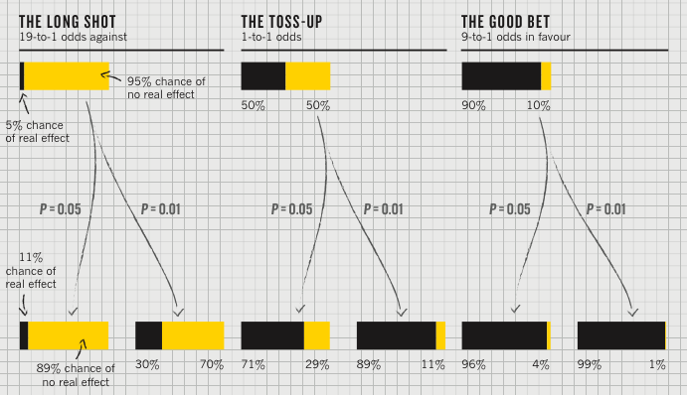
Actual implications of the p-value
P value
Best used to determine what is ‘worthy of a second look’ [Nuzzo]
Limited in its applicability
A small p makes the hypothesis more plausible
Notes:
Does not incorporate the inference (the top of this chart) directly

Slide 60
Regression
Regression tells us to what extent a group of independent variables predict or explain a dependent variable
It is based on the same assumptions as correlation
In addition, predictor variables that are not independent can mess it up
Over fitting can be a problem (too little data for the number of independent variables)

Slide 61
Relationship with correlation
In correlation, the two variables are treated as equals.
In regression, one variable is considered independent (=predictor) variable (X) and the other the dependent (=outcome) variable Y.

Slide 62
What is machine learning?
Automatically or semi-automatically
Inducing concepts (i.e., rules) from data
Finding patterns in data
Explaining data
Making predictions
Supervised ML depends on labels and features
Labels typically expensive to acquire
Features key to success
Notes:
Too many features can lead to overfitting [but feature selection can help with this]
Too few features can fail to capture the information needed for prediction

Slide 63
Learned Classifiers
Training Time
Method to get Ground Truth
Training Data Set
Feature Gen
f₁ | f₂ | f₃ | … | Label
A | 42 | 17 | … | Yes
C | 78 | 25 |  | No
X | 32 | 4 |  | Yes
Learner
Sensors
Classifier

Slide 64
Learned Classifiers
Run/Classify Time
Feature Gen
Sensors
Classifier
Class

Slide 65
Metrics for assessing results
Accuracy [limited value]
Precision = TP / (TP + FP) = 90/(90+15) = 88%
Recall = TP / (TP + FN) = 90/(90+12) = 86%
F-Score = 2 * (Precision * Recall) = 87%
(Precision + Recall)
Kappa = (observed acc.- expected acc.) (1 - expected acc.)
Notes:
Kappa accounts for skew

Slide 66
Best Practices
Divide your data
Optimization set (for tuning parameters; etc.)
Training set (for training your classifier)
Testing set (for calculating scores)
Estimate performance on training set (10 fold cross)
Test set is for reporting
All data is for producing a classifier to use in the real world
Read your data. Explore it. Try things out (feature sets, algthm parameters). But do it all on the optimization set.
Notes:
Called ‘holdout validation’ : need a large enough holdout set so you can trust the result (and this reduces your training data which you almost never have enough of)

Slide 67
Examples
Decision Trees
Add nodes based on information gain
Contain statements about how features relate to outcomes
Naïve Bayes
Elegant balance of features and prior probabilities
Assumptions: Independence; Closed world
[Most of the time in real data sets the values of the different attributes are not independent of each other]

Slide 68
Comparing them
Decision trees [Open World]
Use contingencies between patterns of attribute values as a basis for decision making
Prone to overfitting [need pruning]
Easy to learn, interpret, use
Naïve Bayes [Closed World]
Robust even when features are missing during recognition (because of prior probabilities) but not during training
Fail when data is highly conditional or skewed

Slide 69
Closed [NB] vs Open World [Decision]
Closed:
Presumes all true statements are known
Observer can thus make inferences about new things: if they are not known, they are false
Open:
No single observer has complete information
Observer can only make inferences about things that derive from things it already know to be true
represent information as we discover it and cannot guarantee that we know everything true
statements depending on unknown features are unknown rather than false
Notes:
Closed:
Presumes all true statements are known
Observer can thus make inferences about new things: if they are not known, they are false
Open:
No single observer has complete information
Observer can only make inferences about things that derive from things it already know to be true
represent information as we discover it and cannot guarantee that we know everything true
statements depending on unknown features are unknown rather than false

Slide 70
Least Squares Regression
Given training examples:
x_{1..i} in R^{n} [our feature vectors]
And labels
y_{1..i} in R
We learn
f(x) = w^{T}x + b
Notes:
Note we can replace y-cap with b0 – b1x

Slide 71
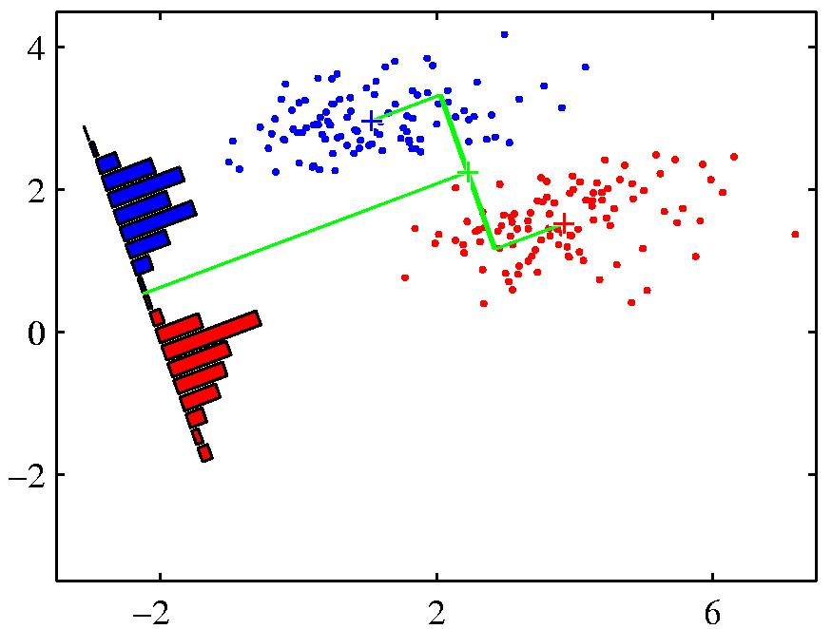
Goal of Logistic Regression
Key idea: instead of predicting a number in R, predict the probability of a class label.
p+ = P(class is positive|features) p- = P(class is negative|features)
Base p on the projection that gives the best separation of the classes.

Slide 72
Regression: Implementing Gradient Descent
Loops over the entire data set S {
At each step change w based on the error and the step size η (the learning rate)
w_{j} = w_{i} - η Δ(w)
simultaneously update all the weights for training instance X_{j}, y_{j}
where p_{w}(x^{(i)}) =
}

Slide 73
How do we handle big data
Batch mode : Gradient Descent
w_{j} = w_{i} - η Δ(w) over the entire data S
Incremental mode: stochastic gradient descent
w_{j} = w_{i} - η * approximation of Δ(w) based on t_{x}-o_{d}
can approximate Batch Gradient Descent arbitrarily closely if η is small enough
supports online learning
easily parallelized
Not guarranteed to reach global minimum

Slide 74
Choosing an Algorithm
 | Decision Trees | Naïve Bayes | SVM* | Rule Learners
Accuracy in general | ** | * | **** | **
Speed of learning given f and n | *** | **** | * | **
Tolerance of missing values | *** | **** | **** | **
Tolerance of irrelevant features | *** | ** | *** | **
Tolerance of interdependent fs | ** | * | *** | **
Discrete/Binary/Continues fs | **** | *** (!cont) | ** (!disc) | *** (!cont)
Tolerance to noise | ** | *** | ** | *
Avoiding overfitting | ** | *** | ** | **
Intelligibility | **** | **** | ** | *
Notes:
Svm is a ‘better’ version of regression for classification
F = num features; n = num instances

Slide 75
Usable Machine Learning
Difficulties with machine learning
Understand what is going on
Control what is going on
Potential cost to user
Corrections
Features
[Labels]

Slide 76

Importance of Intelligibility
Crucial to user’s understanding
What to show users is a critical question that is only partly solve
Different circumstances -> different explanation needs *
How to show is also hard
Several toolkits built by Dey et al to address this
Notes:
Did she fracture any bones in the fall?
How long ago did this happen? How does the system detect falls?
Why did it not tell me about the Museum? How does it determine my loca0on?

Slide 77
Types of Feedback
Feedback: crucial to user’s understanding of how a system works and helping guide future action
What did the system do?
What if I do W, what will the system do?
Why did the system do X?
Why did the system not do Y
How do I get the system to do Z?

Slide 78
Investigations of Mediation Techniques
Multimodal correction
Suhm (98)
McGee et al (98)
Pen Correction
Huerst, Yang & Waibel (98)
Speech Correction
Ainsworth & Pratt (92)
Baber & Hone (93)
Mixed-initiative
Horvitz
Many Others…

Slide 79
Costly features at prediction time
Essence of the problem:
Have limited information on a new test point
Can acquire additional information, but at cost
Different features have different costs
Other examples
Choosing which tests to conduct to make a medical diagnosis
Giving personalized recommendations
Adaptive online surveys
Notes:
Main research result of this work is question ordering on a new test point—we focus on the application to personalized energy estimates, but there are other problems it can be used for too.
Feature cost relates to how likely a person is to answer a question—could be difficulty of answering, but could also be how willing a person is to disclose information (e.g., less willing to give sensitive information like SSN or home address, even if it’s easy to answer) / cost of answering (in the medical test setting)

Slide 80
Example case studies we talked about
Mouse data (different types of users)

Slide 81
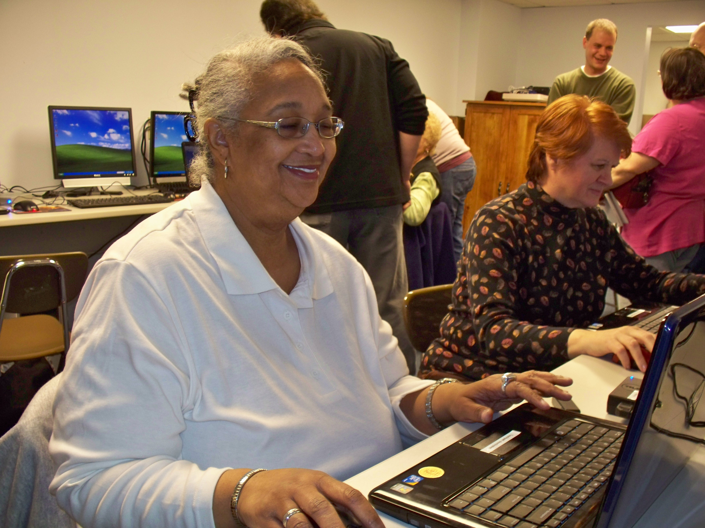
Laptop Deployment: Multiple Groups (July 09 – 10) 17 participants
 | Participants | Female | Average Age | % data collected
Able | 4 | 1 | 29.25 | 22.87%
Older Adult | 8 | 8 | 67.63 | 69.15%
Motor Impaired | 4 | 2 | 41.75 | 7.99%
Notes:
Difficult to segment data

Slide 82
What we learned
✘
✘
Questions
Data Sets
New Questions
✔
Can we characterize pointing problems?
Year of real world data from people with & without pointing problems (and elders)
Can we predict task switches?
Can we predict click targets?
Can we detect pointing problems?
Can we improve targeting?
?
Can we predict what technology will help?
Lab data for people with and without AT
Can we detect routines?
?
Notes:
Are you

Slide 83
What we learned
Questions
Data Sets
Better Questions
✔
Can we characterize pointing problems?
Year of real world data from people with & without pointing problems (and elders)
Visualize how use changes for novice elders over the course of a year
✔
Can we detect pointing problems?
Characterize the aspects of popular applications that are used most/least
✔
?
Can we predict what technology will help?
Lab data for people with and without AT
Predict anything? Hard without labels
?
Notes:
Are you

Slide 84
Example case studies we talked about
Mouse data (different types of users)
Location data [Gates building; Byte]

Slide 85
Location Data Sets
 | Augsburg Occupancy | CMU Occupancy | UCSD Movement | CMU Movement
Collection Method | Smart Door Plate | BACNet Sensor Queries | PDA-based WiFi triangulation | Phone-based WiFi Triangulation
Frequency | Every Room Change | Every 10 minutes | Every 20 sec | Every 30 sec, while movement is detected
Flaws | Summer and Fall data sets 4 month apart
Room vs. Floor vs. Campus | Covers 1 floor in an office building | Covers every floor in one university office building | Covers several campus buildings | Covers every floor in one university office building
Type | Transitional | Occupancy | Tracking | Tracking

Slide 86
Location Data Sets
 | Augsburg Occupancy | CMU Occupancy | UCSD Movement | CMU Movement
Scope | 4 People, (summer + [break] + fall) | 300 data points per day per room (temp & occupancy) | 275 students, M=11 weeks | 6 People
Total locations | 15 | 293 Rooms | 200 | 2074 (10x10 meter segments)
Days | M=23.25 (SD 3.42) | M=188.65 (SD 4.3) | M=25.56 (SD 20.81) | M=58.1 (SD 32.57)
Data points per person/day | M=316.60 (SD 8.55) | N/A | M=508.46 (SD 739.1) | M=497.65 (SD 273.96)
Locations per person/day | M=6.70 (SD 0.70) | N/A | M=3.45 (SD 2.68) | M=44.97 (SD 10.67)

Slide 87
UCSD Data Set Skew

Slide 88
Example case studies we talked about
Mouse data (different types of users)
Location data [Gates building; Byte]

Slide 89
Mobile: Big Data of 1
Accelerometer
Applications
Battery
Bluetooth
Calls
Messaging
Gravity
Gyroscope
Light
Linear Accelerometer
Location
Magnetometer
Network Usage
Orientation
Pressure
Processor
Proximity
Rotation
Screen
Telephony
Temperature
Traffic
Wi-Fi
… many more

Slide 90
Three false assumptions of mobile
Phones are smart [not so much about context]
Apps are used [usually not; usage is also diverse with 95% of sessions < 60secs]
Notifications lead to use [only 25% of use!]
Phones are on & on people
1/5 of the time phones are off
50% in reach; 47% further away
Adapted from http://www.fordham.edu/economics/Vinod/correl-regr.ppt

Slide 91
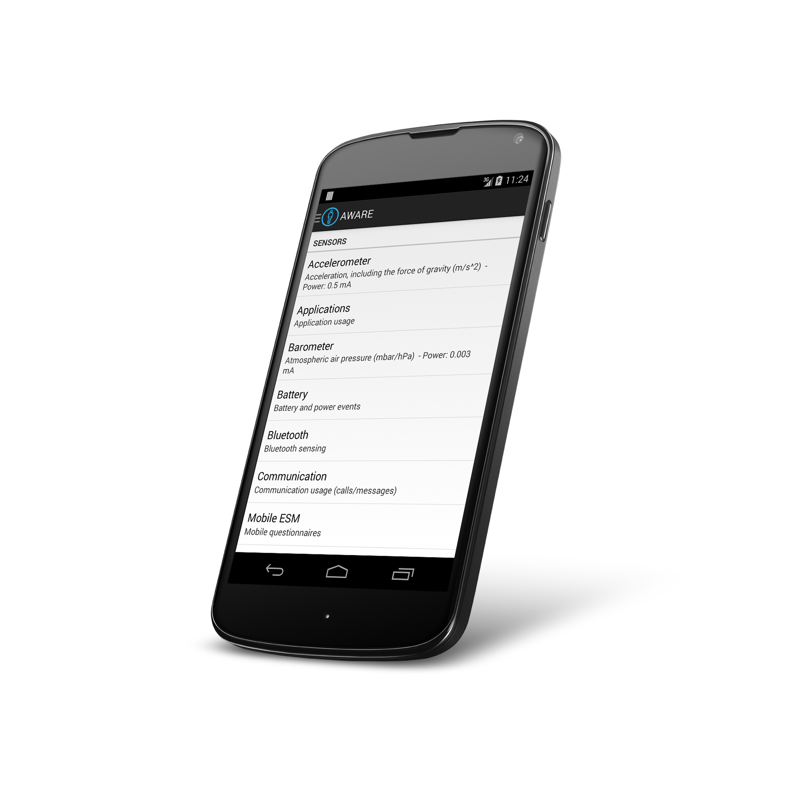
Aware Framework Dey & Ferreira & Kostakos (Oulu)
awareframework.com Collaborative mobile sensing for understanding human behavior and social wellbeing
Developer
Scientist
User

Slide 92
What we learned
Phones are not as omniscient as we might think
Sensor data is collected in uncontrolled conditions thus bound to noise and deficiency
Changing technology a cause of inconsistency in the data
Often lack ground truth

Slide 93
Example case studies we talked about
Mouse data (different types of users)
Location data [Gates building; Byte]
Big Text

Slide 94
Bad Data Handbook
Chose a key-value store + map reduce
Poor debugging experience
Fast write / slow read was a bad match

